Slide 1
Research Methods
Qualitative Data Analysis

Slide 2
Qualitative Data
Data that is not easily reduced to numbers
Data that is related to concepts, opinions, values and behaviors of people
Data that can be broken down through the process of classifying or coding; the pieces of data are then categorized.

Slide 3
What is Qualitative Data Analysis?
Qualitative Data Analysis (QDA) is the range of processes and procedures whereby we move from the qualitative data that has been collected into some form of explanation, understanding or interpretation of the people and situations we are investigating.

Slide 4
What is Qualitative Data Analysis
Data analysis is a process of breaking down data into smaller units, determining their importance, and putting pertinent units together in a more general form.

Slide 5
Data Analysis During Data Collection
Data analysis is an ongoing process throughout the entire research project
Analysis begins with the very first interaction between the researcher and the participants
This is a very important perspective given the interpretive nature of the analysis and the emergent nature of qualitative research designs
Informal steps involve gathering data, examining data, comparing prior data to newer data, and developing new data to gain perspective

Slide 6
Data Analysis After Data Collection
General guidelines and strategies but few specific rules
Common problems
Premature conclusions
Inexperience of the researcher
Self-reinforcement of the researcher’s own ideas without support from the data
Impulsive actions
Desire to finish quickly
Most problems are resolved by spending time “living” with the data

Slide 7
Coding
Coding is a process of reducing the data into smaller groupings so they are more manageable.
The process also helps you to begin to see relationships between categories and patterns of interaction.

Slide 8
Coding
Sections of text transcripts may be marked by the researcher in various ways (underlining in a colored pen, given a numerical reference, or bracketed).

Slide 9
Categories/Themes
A major step in analyzing qualitative data is coding speech/ words/text into meaningful categories/themes.
As you read and reread through the data, you can compile the data into categories or themes

Slide 10
Categories/Themes
A theme/category is generated when similar issues and ideas were expressed by participants.
The theme or category may be labeled by a word or expression taken directly from the data or by one created by the researcher because it seems to best characterize the essence of what is being said.

Slide 11
Organize Data
The field work is over
Attempt to make sense of the data as a whole
Researcher starts with a large set of data and seeks to narrow into small groups of key data
Organizing the materials by type: all observations, all interviews, all field notes…….

Slide 12
Exploring Data
The first step in data analysis is to explore the data
Read through data and make sure all information is complete and legible before proceeding to analysis
Obtain a general sense of the data
Memos - read and write memos about all field notes, observer comments to get an initial sense of the data

Slide 13
Steps in Coding the Data
Get a sense of the whole
Pick one document (e.g. one interview, one field note….). Go through it, asking the question “what is this person talking about?”
Identifying text segments, placing a bracket around them and assigning a code word or phrase that describes the meaning of the text

Slide 14
Steps in Coding the Data
After coding an entire text, make a list of all the code words. Group similar codes and look for redundancy codes
Take the list and go back to the data. Circle specific quotes from participants that support the codes
Reduce the list of codes to get five to seven themes/categories

Slide 15
Identifying Themes
Are there patterns that emerge?
- Events that keep repeating themselves
- Key phrases that participants use to describe their feelings

Slide 16
Themes
Like codes, themes have labels. Types:
Ordinary themes – themes that a researcher might expect to find
Unexpected themes – themes that are surprises
Hard-to-classify themes – themes that contain ideas that do not easily fit into one theme or that overlap
Major and minor themes – themes that represent the major ideas and the minor secondary ideas

Slide 17
Summarizing your Data
After you have coded a set of data, write a summary of what you are learning.
Similarly, summarize the key themes that emerge.
With your data coded and summarized you are ready to look across the various summaries and synthesize your findings across multiple data sources.

Slide 18
RQ: Why do students have problems with critical thinking?
Major and Minor Themes from Teacher s’ Interview
Question What are some of the challenges that your students face in developing their critical thinking skills? How do you help to enhance the critical thinking skills of your students? What supplementary materials do you encourage your students to read within the subject area? | Major Theme Reading Challenges Need authentic learning experience Need to Read newspapers | Minor Theme Time constraints Greater immersion in reading Reading of Journals

Slide 19
Collating Data into a Table of Coded Responses
Interview
(teachers)
Reading challenges
Need to read newspaper
Observation
(students)
Unwilling to work in group
Tardiness
Questionnaire
(students)
Lack of group cohesion
Request teacher’s assistance too frequently
Need authentic learning experience
Laziness and fatigue
Limited independent thinking

Slide 20
Explanation of Themes
Write up and explain the themes in narrative format under the specific research question
Use a few actual quotes from the participants responses to validate your narrative (3 -5 is enough)
Do this for each major theme that emerged from the data

Slide 21
Example of Narrative Format
RQ: Why do students have problem with critical thinking?
Reading challenges. When asked what are the challenges that students face in developing critical thinking skills the teachers interviewed felt that students had reading challenges. Many students were reading below their grade levels with limited vocabulary. This made it difficult for students to decipher the meaning of written work.
The following are some direct quotation from the participants:
[1] “Students do not read on their own. Hence they cannot think critically when given the opportunity”.
[2] “Their reading level”.
[3] “They are unable to decipher the meaning of some key terms used in the question”.

Slide 22
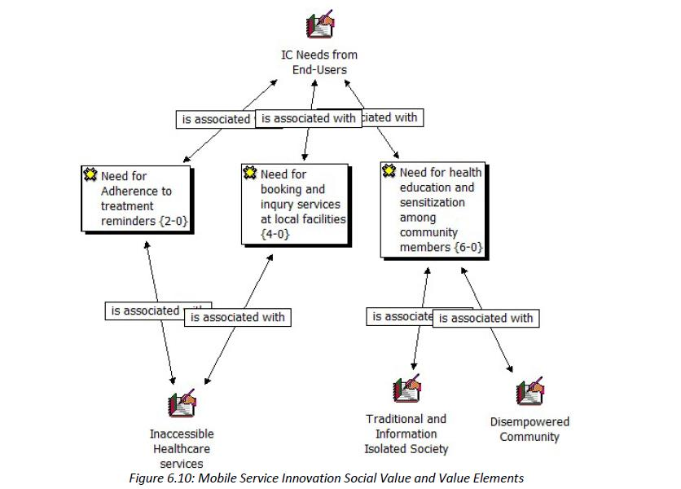
Sample Theme Using Atlas

Slide 23
Thank you for listening
Questions!

